Slide 1

Data Lake Use Cases and Planning Considerations

Slide 2
Whats Data Lake
A data lake is one piece of an overall data management strategy.
Conceptually, a data lake is nothing more than a data repository.
The data lake can store any type of data.
Cost and effort are reduced because the data is stored in its original native format with no structure (schema) required of it initially.

Slide 3
"Schema on Read"
Data lakes usually align with an "ELT" strategy which means we can Extract and Load into the data lake in its original format, then Transform later *if* a need presents itself.
An "ELT" strategy goes along with the "Schema on Read" technique that is prevalent in the big data world.
It's become prevalent because you're able to store the data relatively easily with less up-front time investment, then query the data "where it lives" without being required to relocate the data first (though you may want to later after a solution is productionized).

Slide 4
"Schema on Write"
Conversely, traditional data warehousing typically follows at "ETL" strategy in which the Transformation occurs before the Load to the data warehouse
- this is referred to a "Schema on Write" because the schema, i.e., structure of the data, must be defined before the data is loaded to the data warehouse.
This takes time and effort to do correctly.
It also means we typically need to define use cases ahead of time in order to validate the schema is correct.
We can also expect the use cases and needs to evolve over time - this is a good thing but can be challenging to implement sometimes.

Slide 5
Use Cases For a Data Lake
There are a variety of ways you can use a data lake:
Ingestion of semi-structured and unstructured data sources (aka big data) such as equipment readings, telemetry data, logs, streaming data, and so forth. A data lake is a great solution for storing IoT (Internet of Things) type of data which has traditionally been more difficult to store, and can support near real-time analysis. Optionally, you can also add structured data (i.e., extracted from a relational data source) to a data lake if your objective is a single repository of all data to be available via the lake.
Experimental analysis of data before its value or purpose has been fully defined. Agility is important for every business these days, so a data lake can play an important role in "proof of value" type of situations because of the "ELT" approach discussed above.
Advanced analytics support. A data lake is useful for data scientists and analysts to provision and experiment with data.
Archival and historical data storage. Sometimes data is used infrequently, but does need to be available for analysis. A data lake strategy can be very valuable to support an active archive strategy.

Slide 6
Use Cases For a Data Lake
Support for Lambda architecture which includes a speed layer, batch layer, and serving layer.
Preparation for data warehousing. Using a data lake as a staging area of a data warehouse is one way to utilize the lake, particularly if you are getting started.
Augment a data warehouse. A data lake may contain data that isn't easily stored in a data warehouse, or isn't queried frequently. The data lake might be accessed via federated queries which make its separation from the DW transparent to end users via a data virtualization layer.
Distributed processing capabilities associated with a logical data warehouse.
Storage of all organizational data to support downstream reporting & analysis activities. Some organizations wish to achieve a single storage repository for all types of data. Frequently, the goal is to store as much data as possible to support any type of analysis that might yield valuable findings.
Application support. In addition to analysis by people, a data lake can be a data source for a front-end application. The data lake might also act as a publisher for a downstream application (though ingestion of data into the data lake for purposes of analytics remains the most frequently cited use).

Slide 7
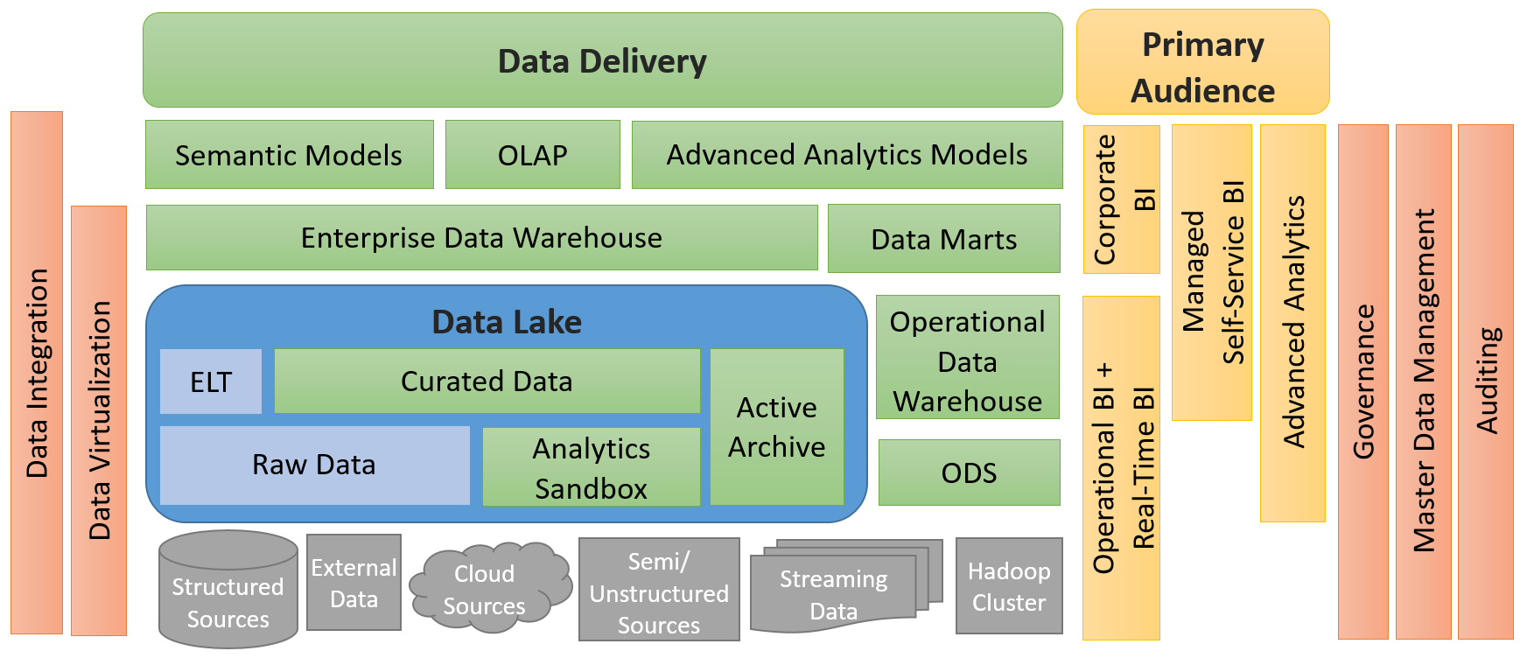

Slide 8

Planning a Data Lake
As we discussed, a data lake reduces the up-front effort of getting data stored because we aren't absolutely required to structure it first.
However, that doesn't mean there's no planning at all.
There's various things you want to consider as you're planning a data lake
-- to prevent it from becoming the dreaded data swamp
-- including things such as:

Slide 9
Planning a Data Lake
Ingestion needs (push / pull via streaming or batch)
Security around data access
Data retention and archival policies
Encryption requirements
Governance
Data quality
Master data management
Validity checks necessary
Metadata management
Organization of data for optimal data retrieval
Scheduling and job management
Logging and auditing
To what extent data federation will be utilized
Enrichment, standardization, cleansing, and curation needs
Technology choices comprising the overall data lake architecture (HDFS, Hadoop components, NoSQL DBs, relational DBs, etc.)
Modular approach to the overall design

Slide 10
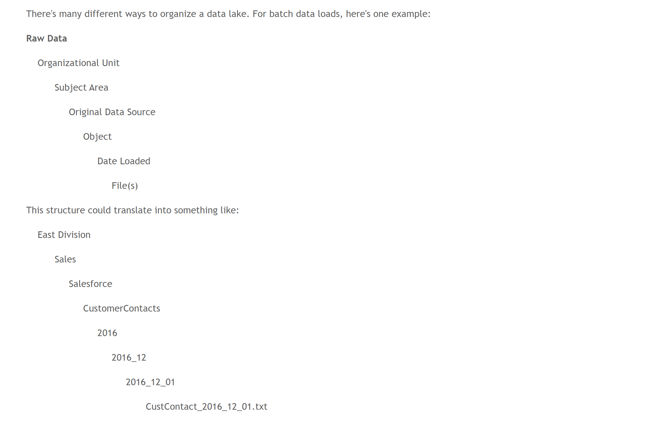

Slide 11
Key points about the "Raw Data" layer:
immutable data (i.e., unchangeable)
deletes rare
batch layer/ speed layer
choice of data format
partitioned by date
generally the dates should go at the end of the path
not mix data schemas in a single folder
raw data should be stored the same as what's contained in the source
very few people have access to the raw data
transient/temporary landing zone prior to the raw data zone

Slide 12
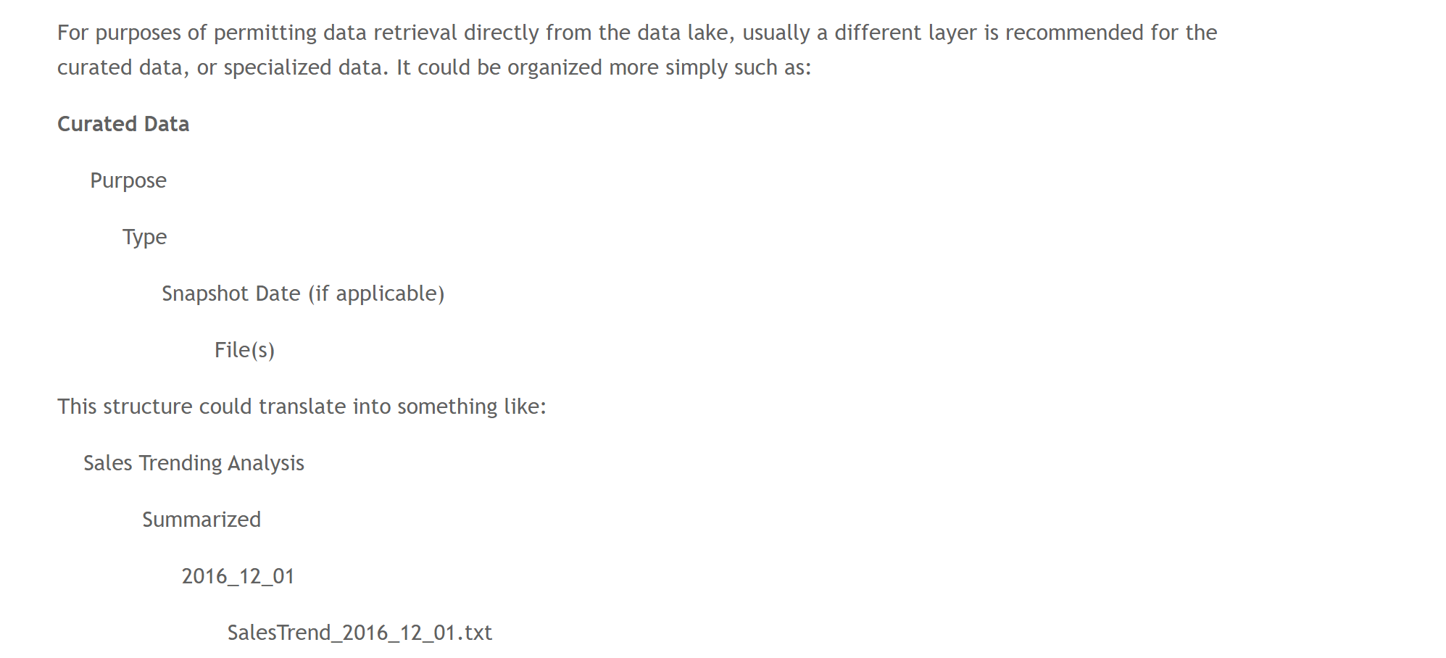

Slide 13
Key points about the "Curated Data" layer:
User queries are from the curated data layer (data hub)
contains data for specific, known, purposes ("Schema on Write“)
data integration and cleansing can, and should occur, in the curated data layer
restructure data to simplify reporting
regenerate the curated data on-demand
friendly names
multiple logical data layers
It's also very common to include a "sandbox" area in your data lake. This provides your highly trained analysts and data scientists an area where they can run processes and write data output.

Slide 14

Organization of the data lake can be influenced by:
Data classification, trust value
Public information
Internal use only
Supplier/partner confidential
Personally identifiable information (PII)
Sensitive - financial
Sensitive - intellectual property
Business impact
High (HBI)
Medium (MBI)
Low (LBI)
Data retention policy
Temporary data
Permanent data
Applicable period (ex: project lifetime)
Subject matter
Source
Security boundaries
Downstream applications & uses
Data load pattern
Real-time, streaming
Incremental
Full load
One time
Time partitioning & probability of data access
Recent/current data
Historical data

Slide 15
Does a Data Lake Replace a Data Warehouse?
Data lake doesn't entirely replace the need for a data warehouse (or data marts) which contain cleansed data in a user-friendly format.
Lessons learned via analysis done from the data lake can often be taken advantage of for the data warehouse
It is true that agility can be faster when conducting analysis directly from the data lake because you're not constrained to a predefined schema
However, that freedom and flexibility come at a cost -- data quality, standardization, and so forth are usually not at the same maturity level as the data warehouse. In other words, "schema on read" systems put more burden on the analyst.
There's always tradeoffs between performing analytics on a data lake versus from a cleansed data warehouse: Query performance, data load performance, scalability, reusability, data quality, and so forth.
For a fast analysis by a highly qualified analyst or data scientist, especially exploratory analysis, the data lake is appealing. For delivering cleansed, user-friendly data to a large number of users across the organization, the data warehouse still rules.

